Slide 1
Advanced Machine Learning: Auto-Regressive Models
Week 3

Slide 2
So Far, Discriminative Models
Mature field
Defining the learning task was straight forward
Mainly served us for motivating neural architecture
Main challenges are:
architecture selection
hyparameter-tuning
But mostly, data collection and labeling

Slide 3
Next: Generative Models
Previously minor goal: put the world into buckets
Grand goal: generating the world
Much harder task!
Learn a model that can generate the world
Reconsider ImageNet
Discrimanative model: how like is this image to contain a dog?
Generative model: how likely is this image to be a dog image?

Slide 4
Generative Modeling Tasks
Generative models: P(x)
Estimation: find density function Q that approximates P
Sampling: draw samples from P
Point estimation: compute the probabilty density of sample x

Slide 5
Example: ImageNet without generalization
Estimation: Q(x) that assigns:
1/N to every imagenet training image
0 otherwise
Sampling: sample a random ImageNet training image
Point estimation: query Q for image x

Slide 6
Example: Non-Gen Results on Test Set
Sampling: cannot sample test set images
Point estimation: test set images give 0 probability

Slide 7
Example: ImageNet with generalization
Estimation: Q(x) - true distribution that generated ImageNet
Sampling: from the true distribution, i.e. new ImageNet images
Point sampling: How likely is x in the true distribution of ImageNet

Slide 8
Conditional Generative Models
Model P(x|y) rather than P(x)
Conditionining can be class labels, text prompt etc.

Slide 9
Example: Class-conditioned ImageNet
Sampling:
sample a new image, given its class is Dalmatian
Point estimation:
how likely is this image to come from the Dalmatian dog distribution

Slide 10
Why Do We Care About This?
World models e.g., GPT (this week)
Human-guided creativity e.g., Text-to-image (in a few weeks)

Slide 11
Several Paradigms for Probability Estimation
Auto-regressive / Non-AR (this week)
Variational
Adversarial
Flow-based
Score-based / Diffusion

Slide 12
Why Learn So Many Paradigms
All have pros and cons
Sometimes a combination works best
Need to choose different paradigms for situation

Slide 13
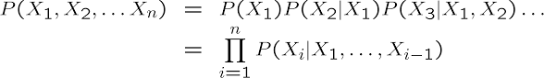
Tower Rule of Probability
P(X, Y) = P(X|Y)P(Y)
This is always true. Independence is when P(X|Y) = P(X)
In the case of N variables, this implies the following decomposition:

Slide 14
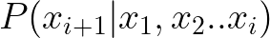
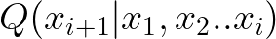
Turning This into an ML Task
We would like to estimate
Assume that X_{i} is a categorical variable
Learn
Estimate Q via cross-entropy:

Slide 15
Example: Language Modeling
Input: a set of sentences decomposed into tokens
Here: token = word
Estimation task: learn model that predict next token, given previous
We do not observe the true
We do observe finite samples from

Slide 16
Example: Language Modeling (2)
Sample: “the”,”cat”,”sat”,”on”,”the”,”mat”
Q(“on”| “the”,”cat”,”sat”) – high likelihood
Q(“mat”| “the”,”cat”,”sat”,”on”,”the”) – high likelihood
Q(“ate”| “the”,”cat”,”sat”,”on”,”the”) – low likelihood

Slide 17
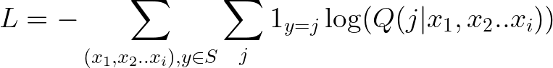
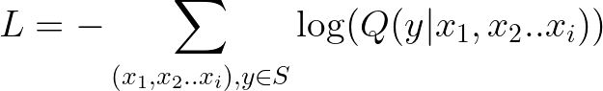
Learning in Practice
Given a set S containing sequences (( ), y)
Learn classifer:
Or more simply:

Slide 18
Language Modeling (2)
In our example, we had a large set of (sentence, next word)
Define each word as a class
Learn a classifier that takes a sequence of words and returns class
It should handle different sequence lengths 0<i<=N

Slide 19
Running Example
The training sample “the cat sat on the mat”
Transform to Q(y|”the”,”cat”,”sat”,”on”,”the”)
Many possible classes: “the”,”cat”,”sat”,”on”,”ate”,”apple”,”dog” etc.
Objective: loss cross entropy with (0,1,0,0,0,0,0,0,…)

Slide 20
Sampling from an AR Model
Assume we trained an AR model
We want to generate a new token sequence x₁..x_{N}
Objective: generate the most likely sequences
Option 1: select the most likely token
Lacks diversity

Slide 21
Sampling New Data (2)
To sample multiple likely sequence, we need stochasticity
Option 2: sample according to the distribution of
high diversity, but maybe too much
Option 3: sample from the top-K tokens
K can tune the amount of diversity

Slide 22
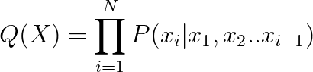
Point Estimation
Provided a model, point estimation is quite easy with AR models
The point probability is simply:
Evaluating log probability is more numerically stable

Slide 23
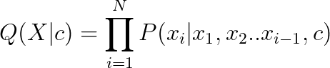
Extension to Conditional AR Models
The framework is easy extended to conditional probs.
The tower rule in this case:
Model estimation, sampling, point estimation: virtually unchanged

Slide 24
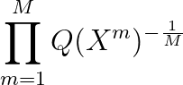
Perplexity: Measure of Model Quality
Test perplexity: the geometric mean of Q on the test set
Intuition: samples of real data should have high likelihood
In our example:
Test sentences: high probability
Garbled sentences: low probability

Slide 25
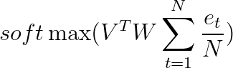
Simple Example: Linear Language Model
Every token t is described by a one-hot vector e_{t}
A linear layer W transforms each token into a dense vector We_{t}
Features of all tokens are average pooled into a fixed representation
The average vector is linearly classified to the next word matrix V

Slide 26
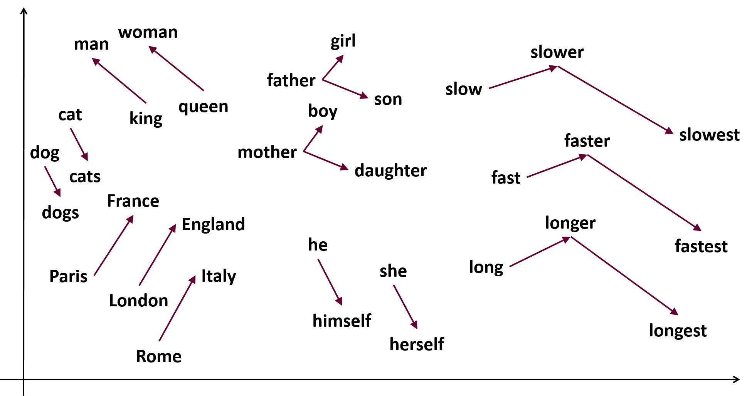
Intuition: Word Representations
Matrix W embeds words into a common vector space
Matrix V maps representations into words
The columns of W correspond to the embeddings of each word
These can be semantic

Slide 27
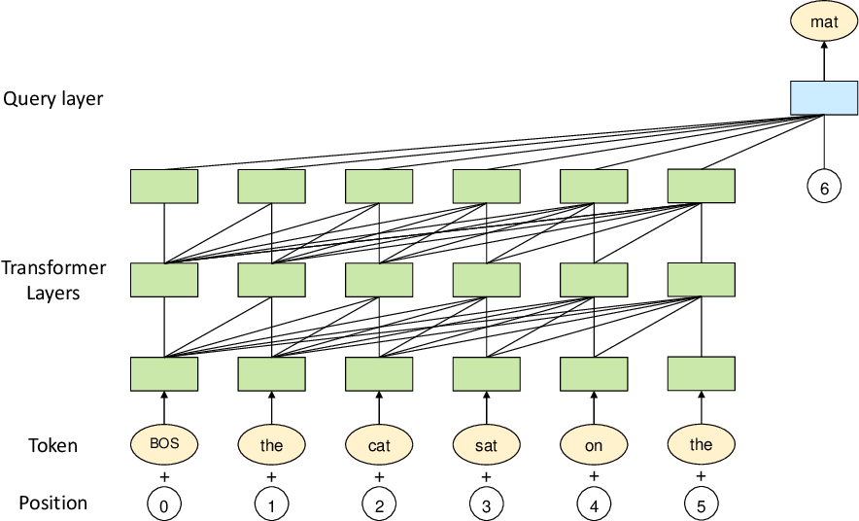
Transformer Language Models
Modern language models use huge transformers
Much more expressive that the simple linear model
Can look at huge context sizes (next word given last 4000 words)
Take word order into account

Slide 28

GPT3 (OpenAI)
Similar to what is used in ChatGPT
Context: 2048 tokens
Parameter number: 175B
Transformer block number: 96
Training data: 0.5 Tn words crawled from the internet

Slide 29

Are LMs the key to Sentient Machines?
”Once LMs can predict all sentences, we can ask them virtually any question and get the correct answer, making them practically sentient” – what do you think?

Slide 30
Conditional LMs: Machine Translation
Predict next word given previous words + source language sentence
About the same solution as before
The paper that started transformers:
“Attention is all you need”, Google 2017

Slide 31
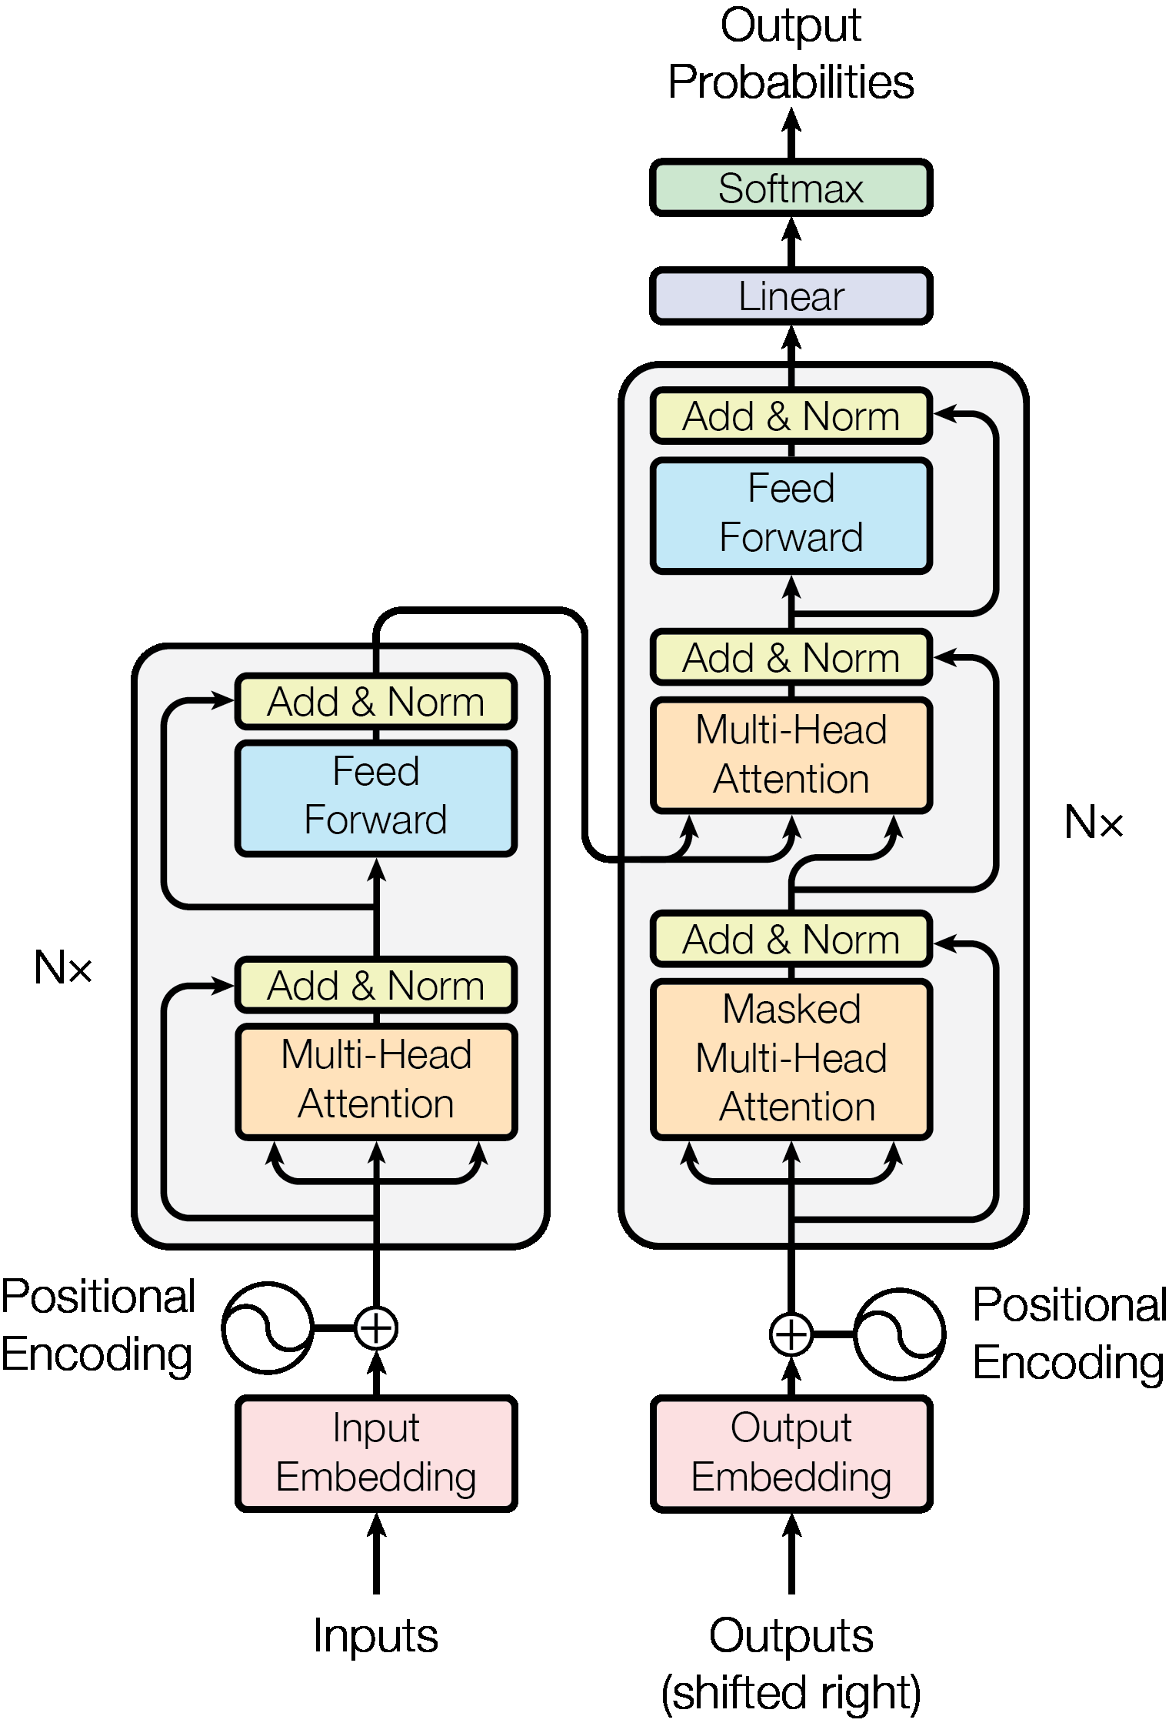
Transformer Implementation
Transformer encoder of source sentence
Transformer decoder over encoding + previous words in target sentence
Why not a decoder over source sentence + previous target sentence words?

Slide 32
Applying the Same Idea to Continuous Data
LM presented so far apply to discrete multivariate data
How can we apply this to continuous data? E.g. images
Idea: quantization
Learn encoder that maps image to a small number of discrete variables
Need to also have a decoder that maps discrete tokens back to image
Then everything else applies as before

Slide 33

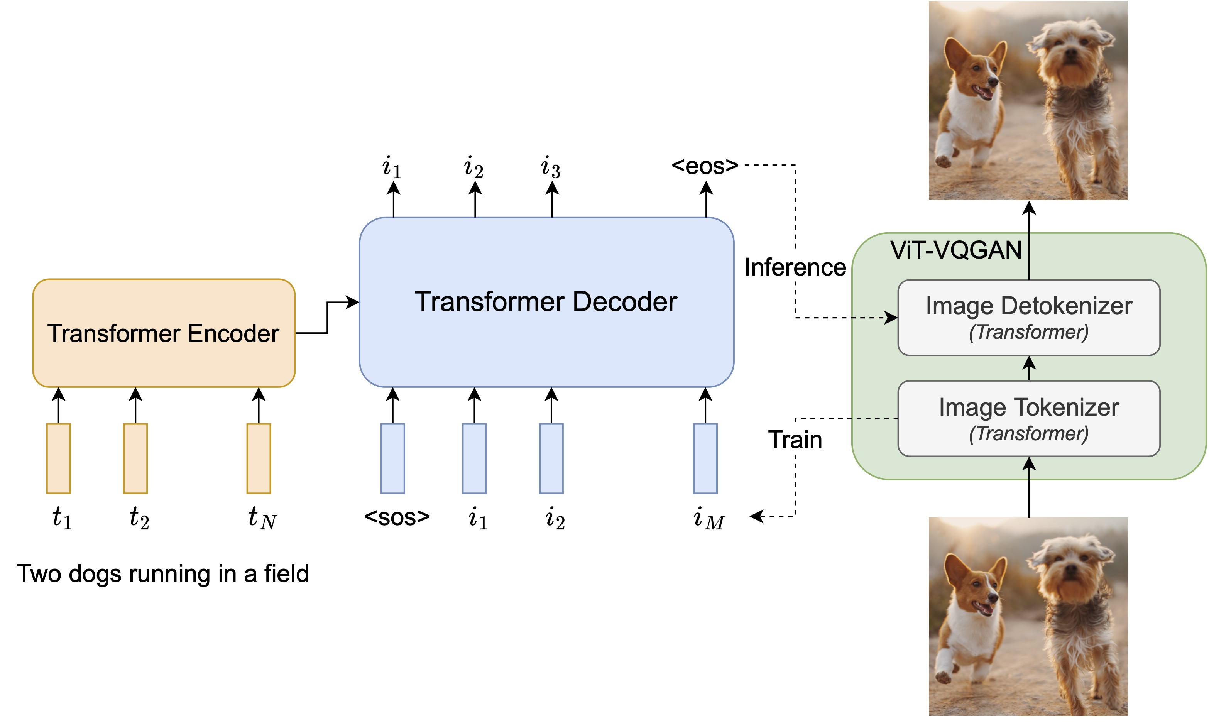
Parti: LM for Text-to-Image Translation
Parti (Google)

Slide 34
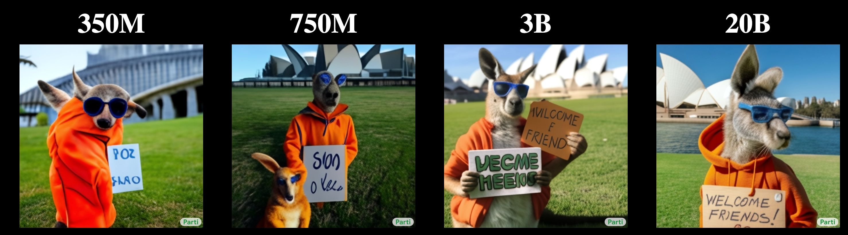
Effect of Number of Parameters
Current models have poor sample and compute complexity
A portrait photo of a kangaroo wearing an orange hoodie and blue sunglasses standing on the grass in front of the Sydney Opera House holding a sign on the chest that says Welcome Friends!

Slide 35
Code Example
https://github.com/karpathy/minGPT

Slide 36
Neural Scaling Laws
Imagine you are a manager in a large company developing LMs
You want: best LM in the world
Have resources but they are finite
Where would you invest them?
Architecture and optimization research?
More data?
More compute?
More memory?

Slide 37
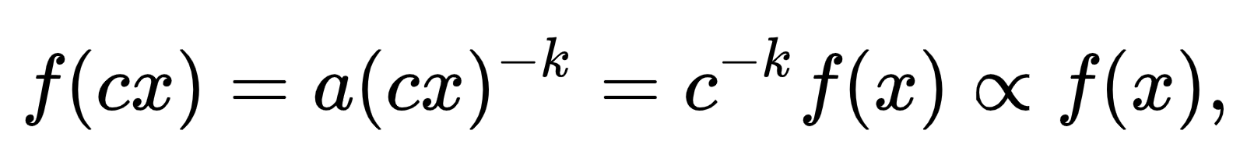
Power Law
Power law: simple way of representating a relation between variable
Product of powers of the variables
Scale invariant

Slide 38
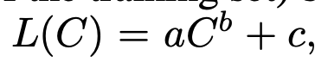
Example: GPT4
How can we know the accuracy of GPT4 on a small budget?
Idea: train a set of smaller models, estimate the power law

Slide 39
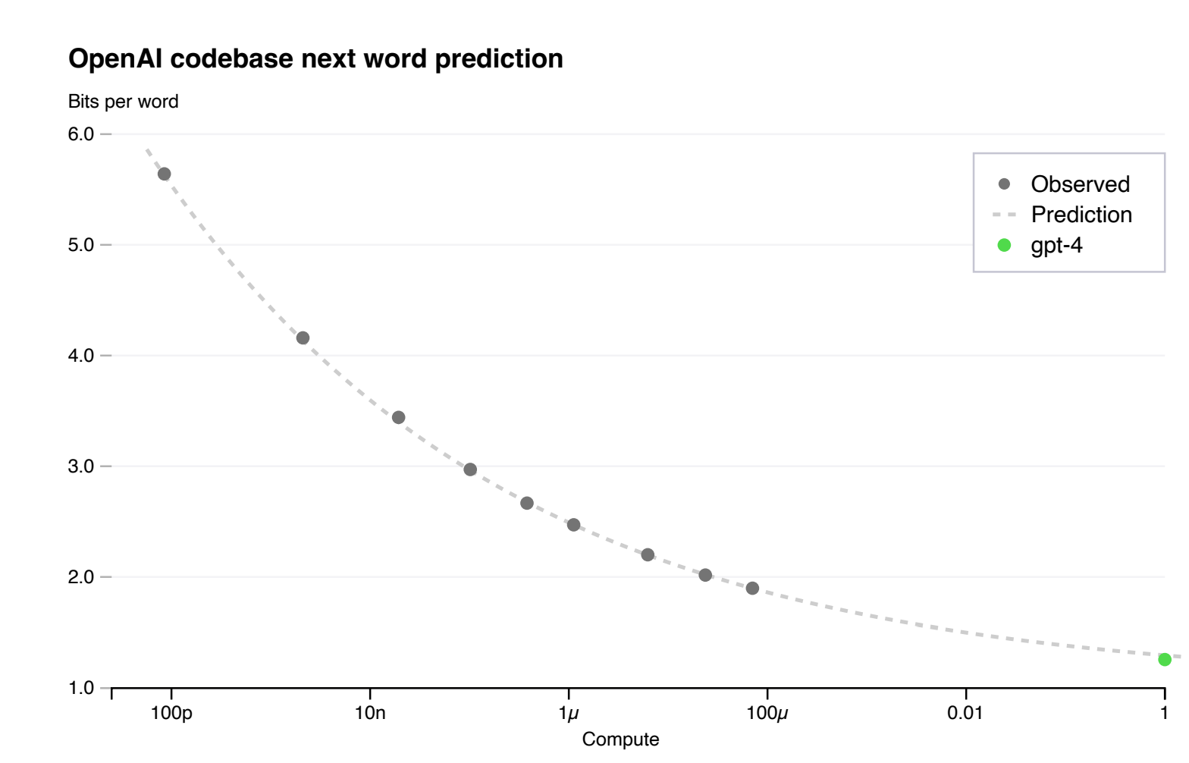
GPT4 Results
Power law predicted true accuracy very accurately
Prediction extrpolating 10000X

Slide 40
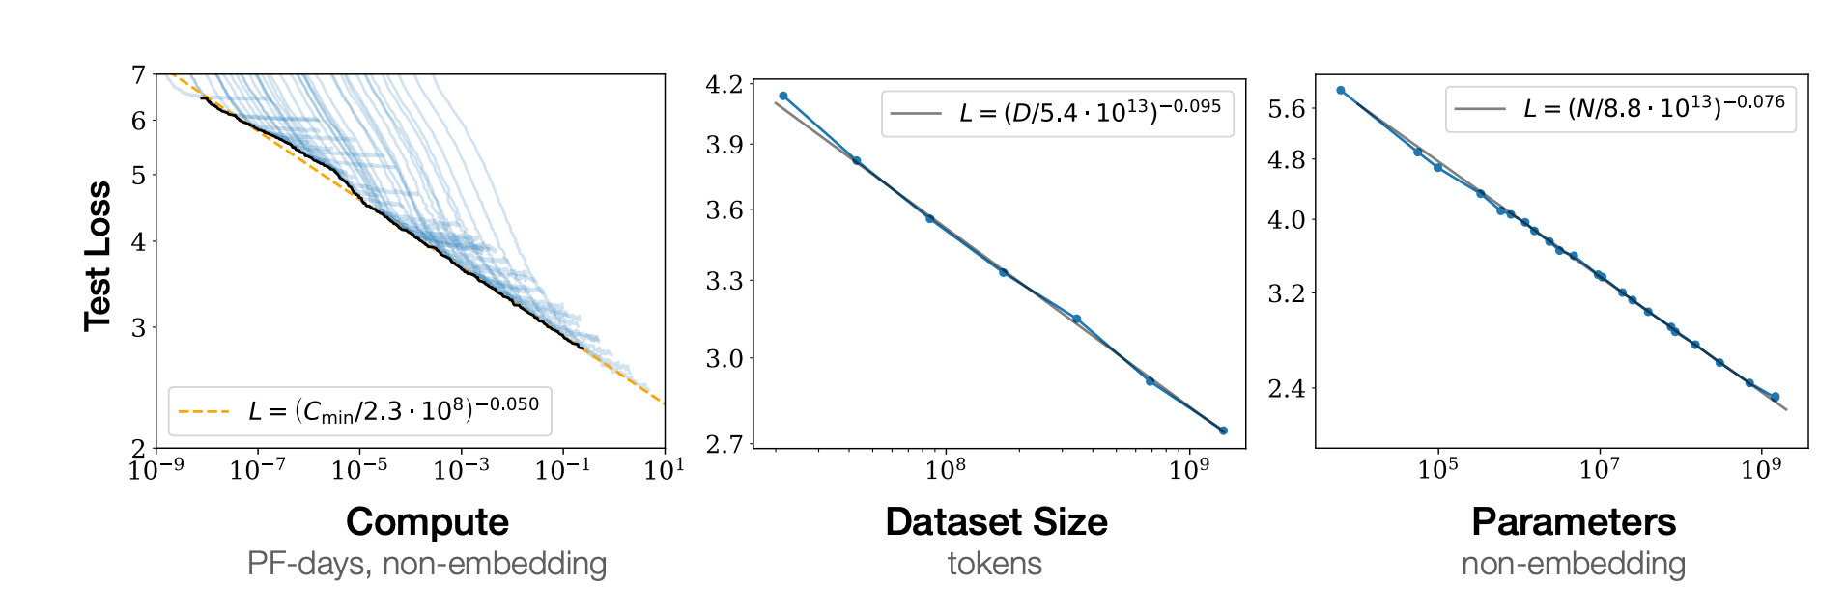
Other Findings in Previous Papers
Only total compute matters – doesn’t matter if it is in depth or width
Larger models require fewer training step to reach given loss

Slide 41
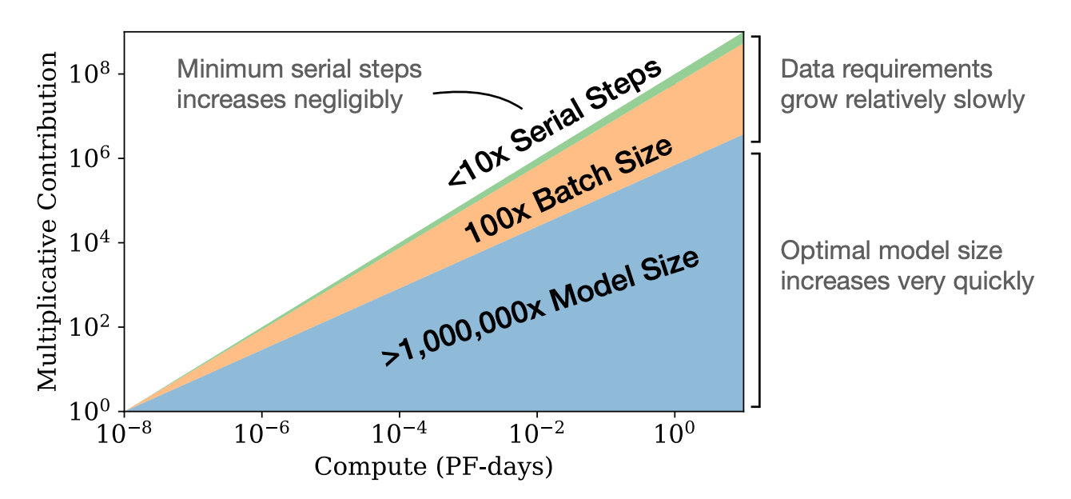
What Should You Invest In?
Given a compute budget:
Scale model a lot
Increase dataset size a little
Moderately increase batch

Slide 42
Conclusion
Language models are a very simple but effective density estimator
Can be conditional or unconditional
Given massive compute, can achieve amazing resultsNot suitable for all types of data
Scaling laws predict their performance very well

